Slide 1
Stacks

Slide 2
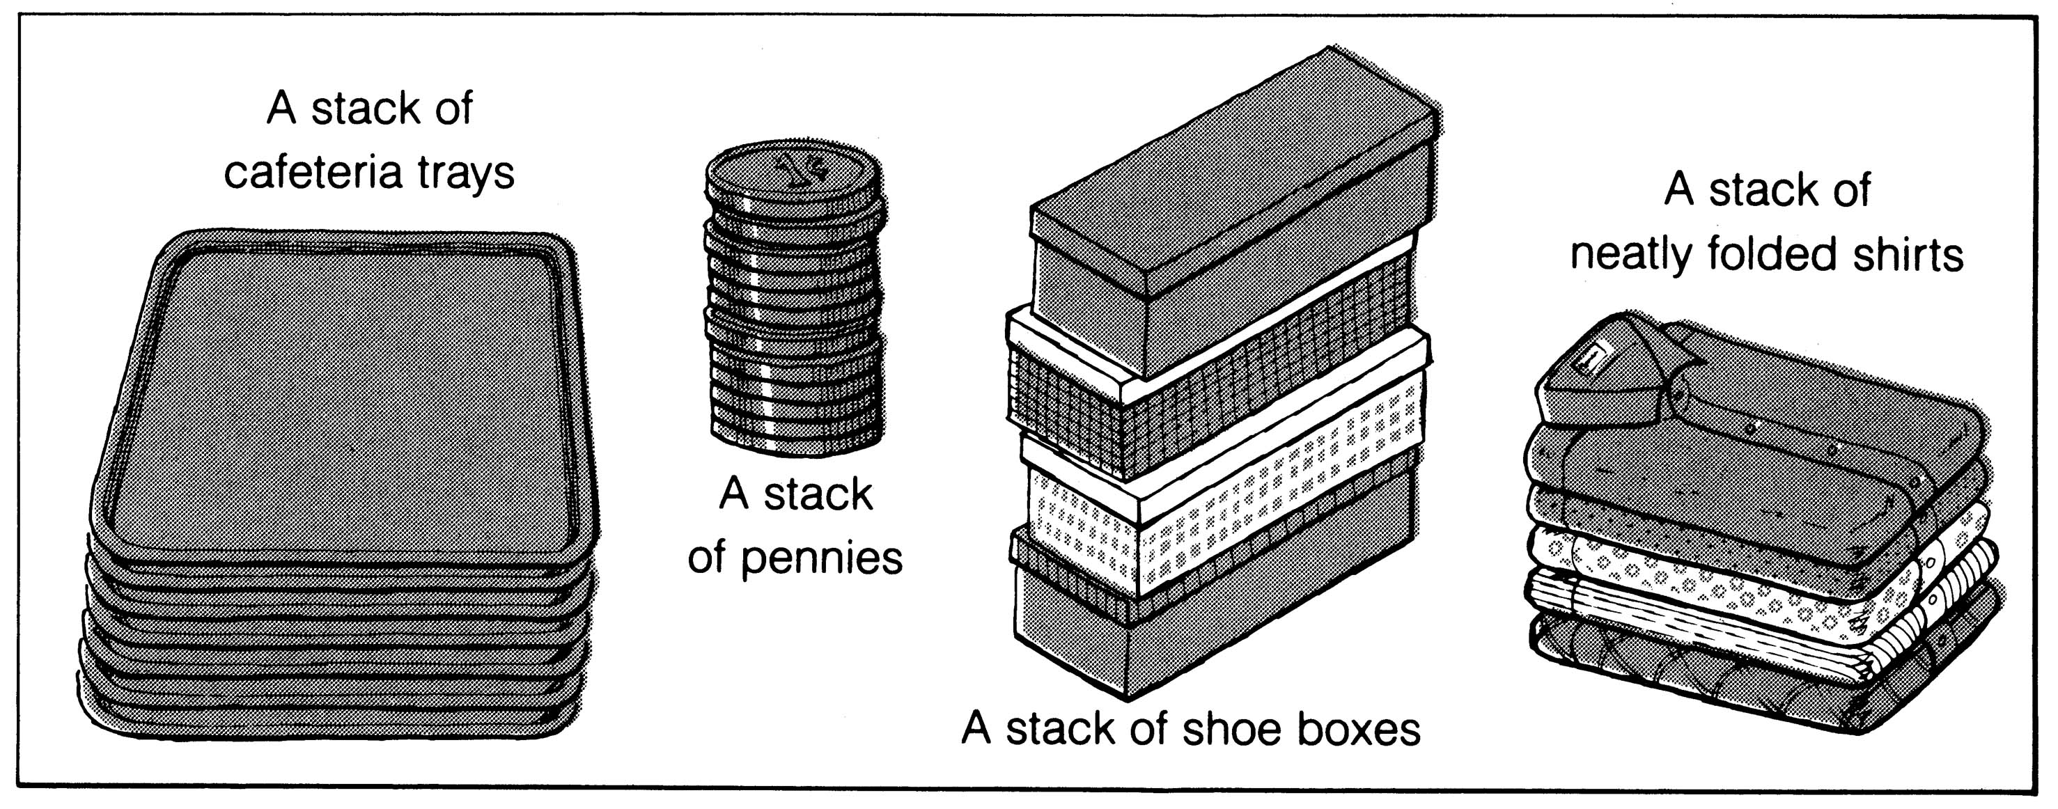
What is a stack?
It is an ordered group of homogeneous items of elements.
Elements are added to and removed from the top of the stack (the most recently added items are at the top of the stack).
The last element to be added is the first to be removed (LIFO: Last In, First Out).

Slide 3
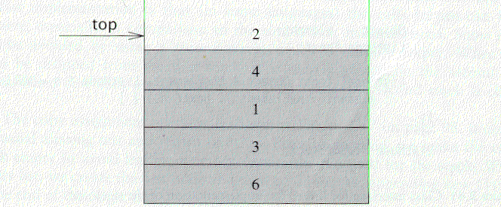
The Stack ADT
A stack is a list with the restriction
  that insertions and deletions can only be performed at the top of the list
  The other end is called bottom
Fundamental/Primitive operations:
  Push: Equivalent to an insert
  Pop: Deletes the most recently inserted element
  Empty: Examines whether the stack is empty

Slide 4
Stack ADT
Stacks are less flexible
  but are more efficient and easy to implement
Stacks are known as LIFO (Last In, First Out) lists.
  The last element inserted will be the first to be retrieved

Slide 5
EXAMPLE
Push 5, 3, 1, Pop, Pop, Push 7
1
3
3
5
5
5
Push 3
Push 1
Push 5
Get 1
Get 3
7
3
5
5
5
Pop
Pop
Push 7

Slide 6
System Stack
process of subroutine calls
  O.S proc. MAIN proc. A1 proc. A2 proc. A3
  run MAIN call A1 call A2 call A3
  q: r: s: t:
  end
q | r | s | t
q
r
s
t
Top/ CURRENT-ADDR

Slide 7
Function Calls
When a subroutine calls another subroutine (including itself) it must first store its register contents.
So, it pushes the register contents into a stack.
The new function uses the registers.
When the program returns to the old function, pop the stack.
Nested Function and Stack Overflow

Slide 8
Applications
  Real life
  Stack of trays in cafeteria
  Piles of books in library
  Computer Science
  Program Execution Stack
  Evaluating Expressions and Syntax Parsing
  Tower of Hanoi
  Undo operations

Slide 9
Implementation of Stack by Array
Implementation of stack ADT
  use an one-dim array stack[MaxSize]
  bottom element is stored in stack[0]
  top points to the top element
    initially, top=-1 for an empty stack
  data member declarations in class
a_{n-1}
class Stack
{
private int items[];
private int top;
private int MaxSize;
public:
......
a₂
a₁
a₀
a₀
a₁
a₂
a_{n-1}
Array index
0
1
2
3
n-1

Slide 10
Implementation of Stack by Array (cont.)
constructor definition
public Stack(int size)
{
items = new int[size];
top = -1;
MaxSize = max;
}
public boolean IsEmpty()
{
return (top == -1);
}

Slide 11
Implementation of Stack by Array (cont.)
member function Top()
    int Top()
    {
    return items[top];
    }

Slide 12
Implementation of Stack by Array (cont.)
Push operation
public void push(int j) // put item on top of stack
{ if (top == maxsize-1)
{
System.out.println("Stack Overflow");
System.exit(-1);
}
else
{
top++;
items[top]=v;
}
}

Slide 13
Implementation of Stack by Array (cont.)
Pop operation
public double pop() // take item from top of stack
{
if (IsEmpty())
{
System.out.println("Stack underflow");
System.exit(-1);
}
else
return items[top--];
}
..\..\Sample\SDemo.java

Slide 14
Example
Consider a mathematical expression that includes several sets of nested parenthesis.
  7 – ((x * (( x + y) / (j - 3)) + Y) / (4 – 2))
  In expression we want to check
  There are an equal number of right and left parenthesis.
  Every right parenthesis is preceded by a matching left parenthesis.
  Expressions like ((A+B) or A+B( violates condition 1 and expressions like )A + B(-C violate condition 2.
  Nested Depth: is the number of scopes that have been opened and not yet closed.
  Parenthesis count: no of left parenthesis – no of right parenthesis.

Slide 15
Example (Cont’d)
Expression id valid if following conditions are met.
  Parenthesis count at end should be zero.
  Parenthesis count at each point in expression should be non negative.
  7 – ( ( x * ( ( x + y ) / ( j - 3 ) ) + Y ) / ( 4 – 2.5 ) )
  0 0 1 2 2 2 3 4 4 4 4 3 3 4 4 4 4 3 2 2 2 1 1 2 2 2 2 1 0
  ( ( A + B ) and (A + B] is illegal
  1 2 2 2 2 1

Slide 16
Algorithm for Example
valid = true
s = empty stack;
while (we have not read the entire string) {
read the next symbol (symb) in the string;
if (symb == ‘(’ || symb == ‘{’ || symb == ‘[’ )
s.push(symb);
if (symb == ‘)’ || symb == ‘}’ || symb == ‘]’ )
if (empty(s))
valid = false;
else{
i = s.pop();
if (i is not the matching opener of symb)
valid = false }
}// end of while
if (!s.empty()) valid = false;
if (valid)
cout << “String is valid”;
else cout << “String is not valid”;

Slide 17
Parenthesis Stack
Consider expression
[x + {y – (a + b)}]
(
{
{
{
[
[
[
[
[ x+{
[ x+{y-(
[ x+{y-(a+b)
[
[
[ x+{y-(a+b)}
[ x+{y-(a+b)}]

Slide 18
Polish Notations
Expression can be written in prefix, postfix or infix notations
+ A B prefix operator precedes operands
A B + postfix operator precedes operands
A + B infix
Unlike Infix notation no parenthesis are required to enforce precedence.
Expressions are evaluated from left to right.

Slide 19
Converting to Prefix, Postfix Notation
Precedence rules are used to convert expression
1) Exponentiation, 2. Multiplication/ Division 3. Addition/Subtraction
Converting to Prefix Notation
(A+B)*C = [+AB]*C = *+ABC
A+(B*C) = A+[*BC) = +A*BC
(A+B)/(C-D)= [+AB]/[-CD] = /+AB-CD
Converting to Postfix Notation
Ex. A+B= AB+
(A+B)*C= [AB+]*C= AB+C*
A+(B*C) = A+[BC*]=ABC*+

Slide 20
Exercises
A$B*C-D+E/F/(G+H)
((A+B)*C-(D-E))$(F+G)
A-B/(C*D$E)
(A+B$D)/(E-F)+G
A*(B+D)/E-f*(G+H/K)

Slide 21
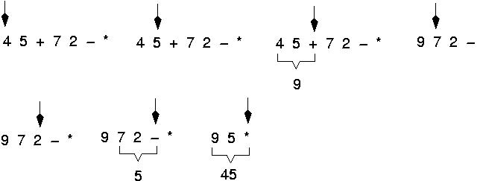
Example: postfix expressions
(cont.)

Slide 22
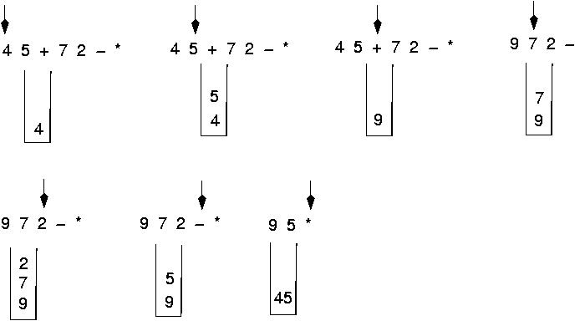
Postfix expressions: using stacks (cont.)

Slide 23
Postfix expressions: Algorithm using stacks (cont.)
opndstk = the empty stack;
while (not end of input){
symb = next input character;
if (symb is an operand)
opndstk.push(symb);
else{
opnd2 = opndstk.pop();
opnd1 = opndstk.pop();
value = result of applying symb to opnd1 and opnd2;
opndstk.push(value) }

Slide 24
EXERCISE
6 2 3 + - 3 8 2 / + * 2 $ 3 +
symb
op1
op2
value
opndstk
6
2
3
+
-
3
8
2
/
+
*
2
$
3
+
6
6 2
6 2 3
6 5
1
1 3
1 3 8
1 3 8 2
1 3 4
1 7
7
7 2
49
49 3
52
2
6
6
6
6
8
3
1
1
7
7
49
3
5
5
5
5
2
4
7
7
2
2
3
5
1
1
1
1
4
7
7
7
49
49
52

Slide 25
Algorithm to Convert Infix Exp to Postfix Expression
1. opstk = the empty stack;
2. while (not end of input){
3. symb = next input character;
4. if (symb is an operand)
add symb to the postfix string
5. else{
6. while (!opstk.empty () && prcd(opstk.Top(), symb)){
7. topsymb = opstk.pop();
8. add topsymb to the postfix string;
} /* end while*/
9. opstk.push(symb);
} /* end else*/
} /* end while*/
10. while (!opstk.empty()){
11. Topsymb = opstk.pop();
12. add topsymb to the postfix string;
} /* end while*/

Slide 26
EXERCISE
A + B * C
symb
Postfix string
opstk
A
+
B
*
C
A
A
AB
AB
ABC
ABC*+
+
+
+ *
+*

Slide 27
EXERCISE
A * B + C
symb
Postfix string
opstk
A
*
B
+
C
A
A
AB
AB*
AB*C
AB*C+
*
*
+
+

Slide 28
Algorithm to Convert Infix Exp to Postfix Expression
9. if (opstk.empty () || symb != ‘)’)
opstk .push(symb);
else
topsymb = opstk.pop();
Precedence rules for parenthesis:
prcd(‘(’,op) = FALSE
Prcd(op,’(’) = FALSE
prcd(op,’)’) = TRUE
prcd(‘)’,op) = undefined

Slide 29
Evaluation of Expressions
Consider the following infix expression
A+(B*C-(D/E$F)*G)*H
Convert into Postfix using Stack
sumb postfix string opstk
A
+
(
B
*
C
-
(
D
/
E
$
F
)
*
G
)
*
H
A
A
A
A B
A B
A B C
A B C *
A B C *
A B C * D
A B C * D
A B C * D E
A B C * D E
A B C * D E F
A B C * D E F $ /
A B C * D E F $ / G
A B C * D E F $ / G * -
A B C * D E F $ / G * -
A B C * D E F $ / G * - H
A B C * D E F $ / G * - H * +
+
+ (
+ (
+ ( *
+ ( *
+ ( -
+ (- (
+ ( - (
+ ( - ( /
+ ( - ( /
+ (- ( /$
+ ( - ( / $
+ ( -
+ ( - *
+ ( - *
+
+ *
+ *

Slide 30
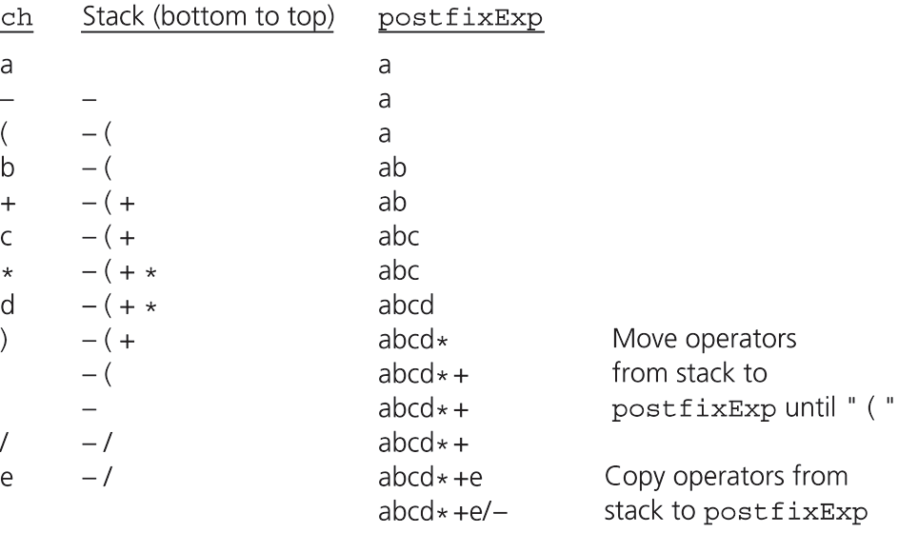
Converting Infix Expressions to Equivalent Postfix Expressions
Figure 6.9
A trace of the algorithm that converts the infix expression a - (b + c * d)/e to postfix form

